Slide 1

Subject: Computer Fundamentals and Organization
Module Number: 1
Module Name: Number Systems and Logic Gates and Combining Logic Gates

Slide 2
Number Systems and Logic Gates and Combining Logic Gates
Syllabus
Number Systems: decimal system; Binary; Octal and Hexadecimal number systems, Place Value, number conversion, Binary Coded Decimal
Logic Gates: The AND Gate; The OR Gate; The Inverter and Buffer; The NAND Gate; The NOR Gate; The Exclusive OR Gate; The Exclusive NOR Gates; The NAND and NOR Gate as an Universal Gate; Gates with more than Two Inputs.
Combining Logic Gates: Constructing Circuits from: Boolean Expression, Drawing a Circuit from a Maxterm and Minterm Boolean Expression; Truth Tables and Boolean Expressions;, Boolean postulates, Demorgan’s theorem.

Slide 3
Number Systems and Logic Gates and Combining Logic Gates
Aim
The aim of this module is to make students understand computer working process, the way it stores the data, interprets the information and renders the results in a human readable form.

Slide 4
Number Systems and Logic Gates and Combining Logic Gates
Objectives
The objectives of this module are to:
Learn the number systems and fundamentals of logic gates.
Simplify Boolean expressions and use data processing circuits.
Understand working of Arithmetic Logic Unit.
Apply different addressing modes.
Learn the Input/Output Organization, interrupts and memory system.

Slide 5
Number Systems and Logic Gates and Combining Logic Gates
Outcomes
At the end of this module, students will be able to:
Solve problems on number systems and fundamentals of logic gates.
Simplify Boolean expressions and use data processing circuits.
Analyse the working of Arithmetic Logic Unit.
Apply different addressing modes.
Interpret Input/Output Organization, interrupts and memory system.

Slide 6
Number Systems and Logic Gates and Combining Logic Gates
Table of Contents
Introduction to Number System
Conversion From Other Bases to Decimal Number System
Binary Coded Decimal
Logic Gate
Universal Gates
Minterm and Maxterm
Truth Tables
Demorgan’s Theorems.

Slide 7
Number Systems and Logic Gates and Combining Logic Gates
Introduction to Number System
The system for naming or representing numbers is known as the number system or numeral system.
A number is a mathematical value that can be used to measure, count, and do other types of calculations.
Different mathematical number systems include: System of decimal numbers (Base- 10)System of binary numbers (Base- 2)system of octal numbers (Base-8)Hexadecimal system of numbers (Base- 16)
Notes:
Source: https://www.researchgate.net/figure/The-elements-of-computational-thinking_fig1_333826796

Slide 8
Number Systems and Logic Gates and Combining Logic Gates
The decimal number system has a base of 10 because it uses ten digits from 0 to 9.
Example of Decimal Number System:
The decimal number 2456 consists of the digit 6 in the units position, 5in the tens place, 4 in the hundreds position, and 2 in the thousands place whose value can be written as:
(2×10³) + (4×10²) + (5×10¹) + (6×10⁰)
(2×1000) + (4×100) + (5×10) + (6×1)
2000 + 400 + 50 + 6=2456

Slide 9
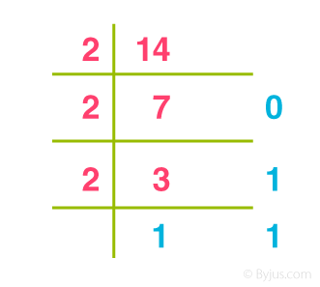
Number Systems and Logic Gates and Combining Logic Gates
Binary Number System (Base 2 Number System)
The base 2 number system is also known as the Binary number system wherein, only two binary digits exist, i.e., 0 and 1. Specifically, the usual base-2 is a radix of 2. The figures described under this system are known as binary numbers which are the combination of 0 and 1. For example, 110101 is a binary number.
Base 2 Number System Example
∴ (14)₁₀ = 1110₂

Slide 10
Number Systems and Logic Gates and Combining Logic Gates
Octal Number System (Base 8 Number System)
In the octal number system, the base is 8 and it uses numbers from 0 to 7 to represent numbers. Octal numbers are commonly used in computer applications. Converting an octal number to decimal is the same as decimal conversion and is explained below using an example.
Example: Convert 215₈ into decimal.
Solution:
215₈ = 2 × 8² + 1 × 8¹ + 5 × 8⁰
= 2 × 64 + 1 × 8 + 5 × 1
= 128 + 8 + 5
= 141₁₀

Slide 11
Number Systems and Logic Gates and Combining Logic Gates
Hexadecimal Number System (Base 16 Number System)
In the hexadecimal system, numbers are written or represented with base 16.
In the hex system, the numbers are first represented just like in the decimal system, i.e. from 0 to 9.
The numbers are represented using the alphabet from A to F.

Slide 12
Number Systems and Logic Gates and Combining Logic Gates
Conversion From Other Bases to Decimal Number System
Binary to Decimal
Example: Convert (11011)₂ to decimal number.
Solution: Given (11011)₂ a binary number.
We need to multiply each binary digit with the decreasing power of 2.
That is;
1×2⁴+1×2³+0x2²+1×2¹+1×2⁰
=16+8+0+2+1
=27
Therefore, (11011)₂ = (27)₁₀
Notes:
Source: https://rsdlearning.redmondschools.org/2020/01/07/coding-a-natural-way-to-bring-about-computational-thinkers/

Slide 13
Number Systems and Logic Gates and Combining Logic Gates
Octal to Decimal
Example: Convert 121₈ into the equivalent decimal number.
Solution: Given (121)₈ is an octal number
Here, we have to multiply each octal digit with the decreasing power of 8, such as;
1×8²+2×8¹+1×8⁰
=64+16+1
=81

Slide 14
Number Systems and Logic Gates and Combining Logic Gates
Hexadecimal to Decimal
Example: Convert 12₁₆ into a decimal number.
Solution: Given 12₁₆
Multiply each digit with decreasing power of 16 (Place Value) to obtain an equivalent decimal number.
1×16¹+2×16⁰
=16+2
=18

Slide 15
Number Systems and Logic Gates and Combining Logic Gates
Binary Coded Decimal
It involves translating decimal integers into their equivalents in binary.
Each digit of a decimal number is represented as a set of bits in this type of binary encoding.
The option of using 4-bit or 8-bit for this encoding (usually 4-bit is preferred).
Compared to the current binary system, it is a quick and effective mechanism for converting decimal numbers into binary numbers.
These are typically utilised in digital displays where manipulating data might be challenging.
BCD is so crucial in this situation since each digit is manipulated as a separate single sub-circuit.
Notes:
Source: Computational thinking - A beginner's guide to problem solving & programming Karl Beecher

Slide 16
Number Systems and Logic Gates and Combining Logic Gates
The BCD equivalent of a decimal number is written by replacing each decimal digit in the integer and fractional parts with its four bit binary equivalent.
BCD code is more precisely known as 8421 BCD code , with 8,4,2 and 1 representing the weights of different bits in the four-bit groups, Starting from MSB and proceeding towards LSB.
This feature makes it a weighted code , which means that each bit in the four bit group representing a given decimal digit has an assigned weight.

Slide 17
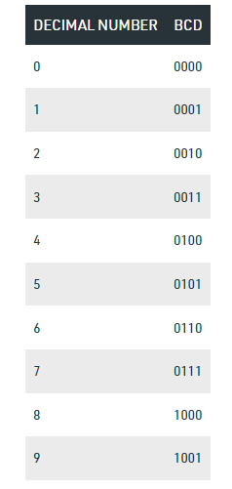
Number Systems and Logic Gates and Combining Logic Gates
Truth Table for Binary Coded Decimal

Slide 18
Number Systems and Logic Gates and Combining Logic Gates
Conversion to BCD
In the BCD numbering system, the given decimal number is segregated into chunks of four bits for each decimal digit within the number.
Each decimal digit is converted into its direct binary form (usually represented in 4-bits).
For example:
1. Convert (123)10 in BCD )
From the truth table 1 -> 0001 2 -> 0010 3 -> 0011 thus, BCD becomes -> 0001 0010 0011
2. Convert (324)10 in BCD
(324)10 -> 0011 0010 0100 (BCD)
Again from the truth table above, 3 -> 0011 2 -> 0010 4 -> 0100 Thus, BCD becomes -> 0011 0010 0100

Slide 19
Number Systems and Logic Gates and Combining Logic Gates
LOGIC GATE
A logic gate is a device that acts as a building block for digital circuits. They perform basic logical functions that are fundamental to digital circuits. Most electronic devices we use today will have some form of logic gates in them. For example, logic gates can be used in technologies such as smartphones, tablets or within memory devices.
Notes:
Source: https://www.techtarget.com/whatis/definition/logic-gate-AND-OR-XOR-NOT-NAND-NOR-and-XNOR

Slide 20
Number Systems and Logic Gates and Combining Logic Gates
In a circuit, logic gates will make decisions based on a combination of digital signals coming from its inputs. Most logic gates have two inputs and one output.
Logic gates are based on Boolean algebra. At any given moment, every terminal is in one of the two binary conditions, false or true.
False represents 0, and true represents 1. Depending on the type of logic gate being used and the combination of inputs, the binary output will differ.
Logic gates are commonly used in integrated circuits (IC).
Basic logic gates
There are seven basic logic gates:
AND, OR, XOR, NOT, NAND, NOR, and XNOR.
Notes:
Source:Computational thinking - A beginner's guide to problem solving & programming Karl Beecher

Slide 21
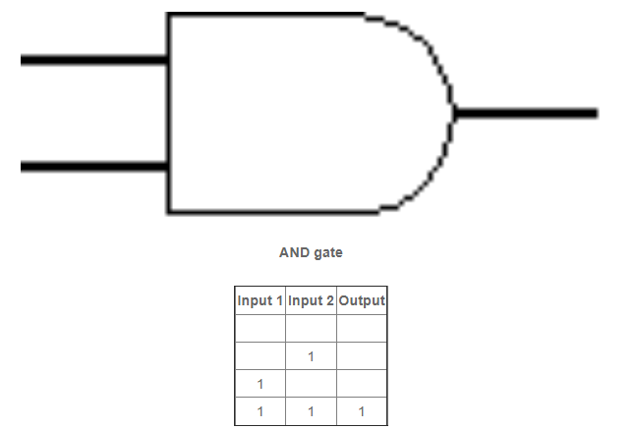
Number Systems and Logic Gates and Combining Logic Gates
The AND gate is so named because, if 0 is called "false" and 1 is called "true," the gate acts in the same way as the logical "and" operator.
The following illustration and table show the circuit symbol and logic combinations for an AND gate. (In the symbol, the input terminals are at left and the output terminal is at right.)
The output is "true" when both inputs are "true." Otherwise, the output is "false." In other words, the output is 1 only when both inputs one AND two are 1.
AND GATE
Notes:
Source: https://www.techtarget.com/whatis/definition/logic-gate-AND-OR-XOR-NOT-NAND-NOR-and-XNOR

Slide 22
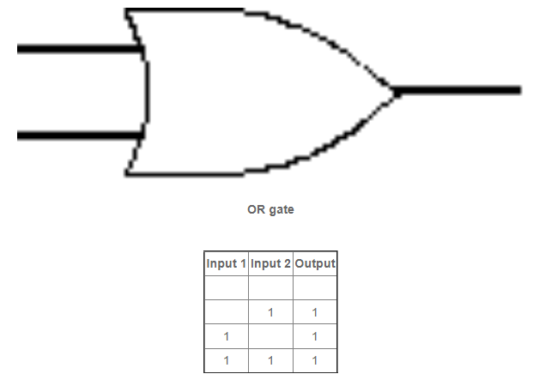
Number Systems and Logic Gates and Combining Logic Gates
The OR gate gets its name from the fact that it behaves after the fashion of the logical inclusive "or." The output is "true" if either or both of the inputs are "true." If both inputs are "false," then the output is "false." In other words, for the output to be 1, at least input one OR two must be 1.
OR GATE
Notes:
Source: Computational thinking - A beginner's guide to problem solving & programming Karl Beecher

Slide 23
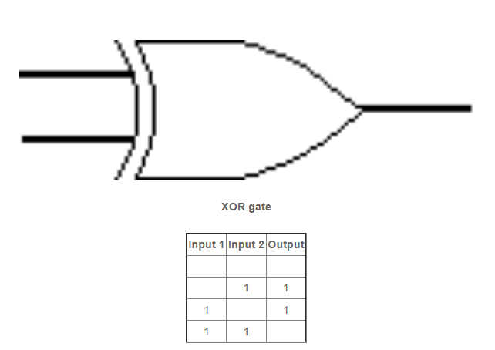
Number Systems and Logic Gates and Combining Logic Gates
The XOR ( exclusive-OR ) gate acts in the same way as the logical "either/or." The output is "true" if either, but not both, of the inputs are "true." The output is "false" if both inputs are "false" or if both inputs are "true." Another way of looking at this circuit is to observe that the output is 1 if the inputs are different, but 0 if the inputs are the same.
XOR GATE
Notes:
Source: https://www.techtarget.com/whatis/definition/logic-gate-AND-OR-XOR-NOT-NAND-NOR-and-XNOR

Slide 24
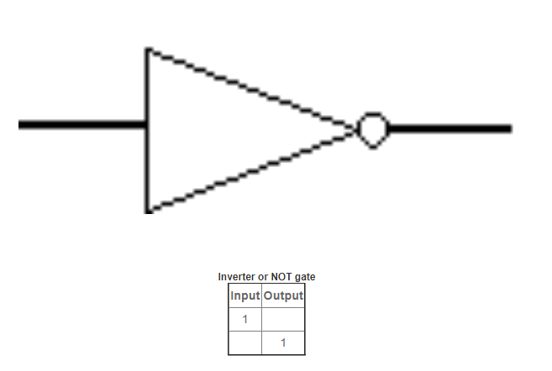
Number Systems and Logic Gates and Combining Logic Gates
A logical inverter, sometimes called a NOT gate to differentiate it from other types of electronic inverter devices, has only one input. It reverses the logic state. If the input is 1, then the output is 0. If the input is 0, then the output is 1.
NOT GATE
Notes:
Source:https://www.techtarget.com/whatis/definition/logic-gate-AND-OR-XOR-NOT-NAND-NOR-and-XNOR

Slide 25
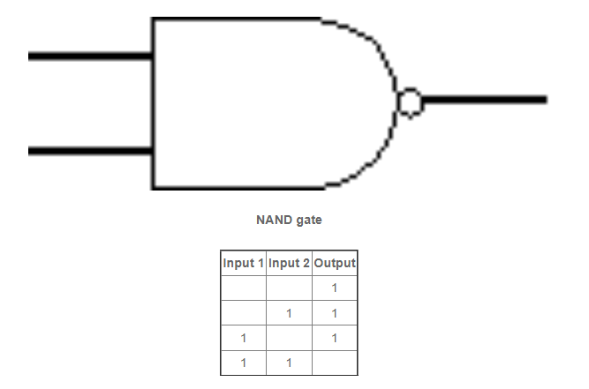
Number Systems and Logic Gates and Combining Logic Gates
The NAND gate operates as an AND gate followed by a NOT gate. It acts in the manner of the logical operation "and" followed by negation. The output is "false" if both inputs are "true." Otherwise, the output is "true."
NAND GATE
Notes:
Source:https://www.techtarget.com/whatis/definition/logic-gate-AND-OR-XOR-NOT-NAND-NOR-and-XNOR

Slide 26
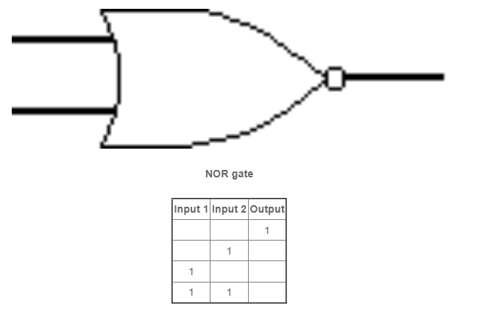
Number Systems and Logic Gates and Combining Logic Gates
The NOR gate is a combination OR gate followed by an inverter. Its output is "true" if both inputs are "false." Otherwise, the output is "false."
NOR GATE
Notes:
Source:https://www.techtarget.com/whatis/definition/logic-gate-AND-OR-XOR-NOT-NAND-NOR-and-XNOR

Slide 27
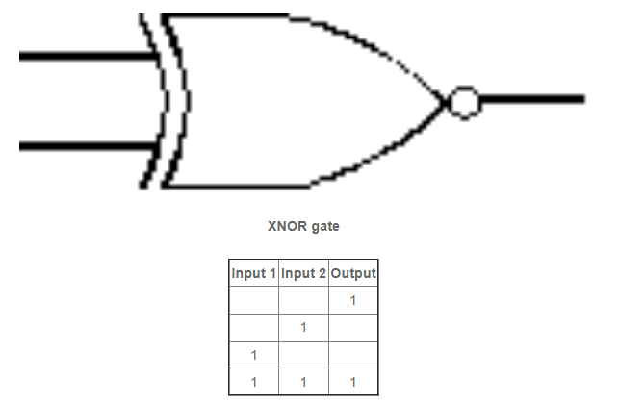
Number Systems and Logic Gates and Combining Logic Gates
The XNOR (exclusive-NOR) gate is a combination XOR gate followed by an inverter. Its output is "true" if the inputs are the same, and "false" if the inputs are different.
XNOR GATE
Notes:
Source:https://www.techtarget.com/whatis/definition/logic-gate-AND-OR-XOR-NOT-NAND-NOR-and-XNOR

Slide 28
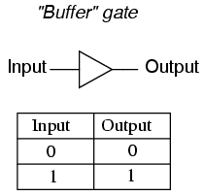
Number Systems and Logic Gates and Combining Logic Gates
Buffer gate is the opposite of a NOT gate and does not change the output.
The Buffer Gate is a logic block that takes any input and compares the value to 0. If the input signal is zero, the output will be zero. If the input is non-zero, the output will be a “1”.
The main purpose of a buffer is to regenerate the input, usually using a strong high and a strong low. A buffer has one input and one output; its output always equals its input.
Buffer GATE
Notes:
Source:https://www.techtarget.com/whatis/definition/logic-gate-AND-OR-XOR-NOT-NAND-NOR-and-XNOR

Slide 29
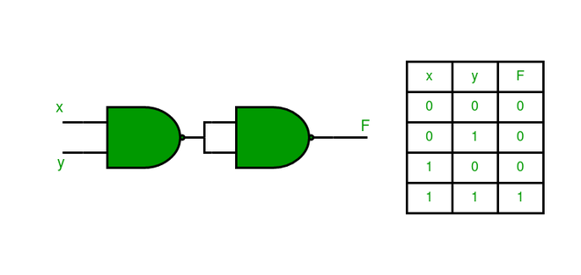
Number Systems and Logic Gates and Combining Logic Gates
Universal Gates
In Boolean Algebra, the NAND and NOR gates are called universal gates because any digital circuit can be implemented by using any one of these two i.e. any logic gate can be created using NAND or NOR gates only.
Implementation of AND Gate using Universal gates.
a) Using NAND Gates
The AND gate can be implemented by using two NAND gates in the below fashion:
Notes:
Source:https://www.techtarget.com/whatis/definition/logic-gate-AND-OR-XOR-NOT-NAND-NOR-and-XNOR

Slide 30
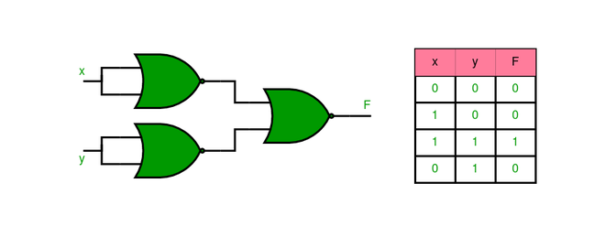
Number Systems and Logic Gates and Combining Logic Gates
b) Using NOR Gates
Implementation of AND gate using only NOR gates as shown:
Notes:
Source:https://www.techtarget.com/whatis/definition/logic-gate-AND-OR-XOR-NOT-NAND-NOR-and-XNOR

Slide 31
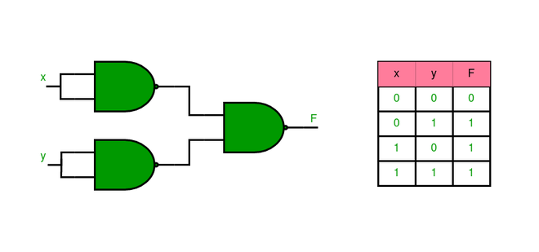
Number Systems and Logic Gates and Combining Logic Gates
2. Implementation of OR Gate using Universal gates.
Using NAND Gates
The OR gate can be implemented using the NAND gate
as shown:
Notes:
Source:https://www.techtarget.com/whatis/definition/logic-gate-AND-OR-XOR-NOT-NAND-NOR-and-XNOR

Slide 32
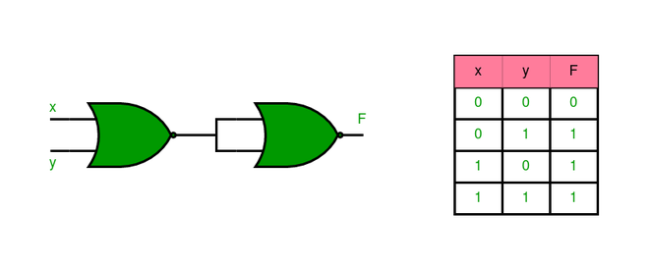
Number Systems and Logic Gates and Combining Logic Gates
b) Using NOR Gates
Implementation of OR gate using two NOR gates as shown in the picture below:
Notes:
Source:https://www.techtarget.com/whatis/definition/logic-gate-AND-OR-XOR-NOT-NAND-NOR-and-XNOR

Slide 33
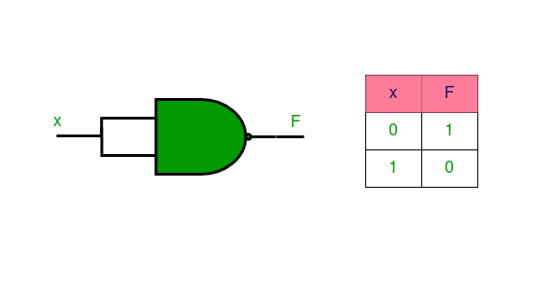
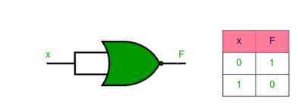
Number Systems and Logic Gates and Combining Logic Gates
3. Implementation of NOT Gate using Universal gates.
a) Using NAND Gates
b) Using NOR Gates
Notes:
Source:https://www.techtarget.com/whatis/definition/logic-gate-AND-OR-XOR-NOT-NAND-NOR-and-XNOR

Slide 34
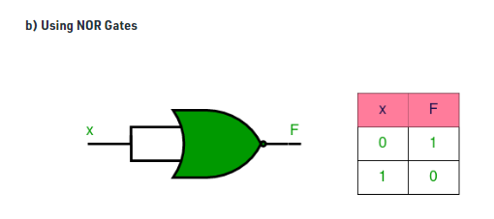
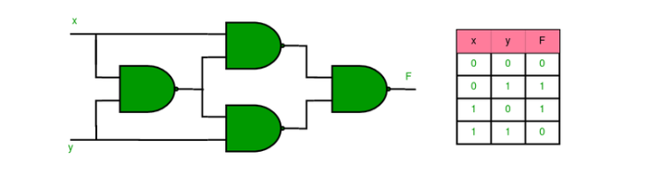
Number Systems and Logic Gates and Combining Logic Gates
4. Implementation of XOR Gate using Universal gates.
Using NAND Gates
Notes:
Source:https://www.techtarget.com/whatis/definition/logic-gate-AND-OR-XOR-NOT-NAND-NOR-and-XNOR

Slide 35
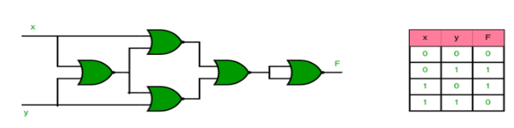
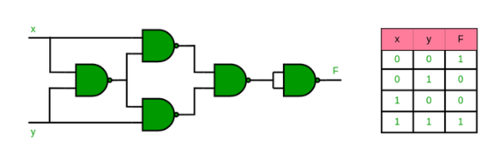
Number Systems and Logic Gates and Combining Logic Gates
b) Using NOR Gate
5. Implementation of XNOR Gate using Universal gates.
Using NAND Gate
Notes:
Source:https://www.techtarget.com/whatis/definition/logic-gate-AND-OR-XOR-NOT-NAND-NOR-and-XNOR

Slide 36
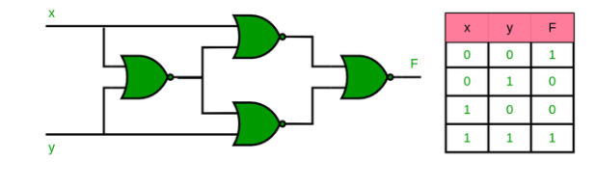
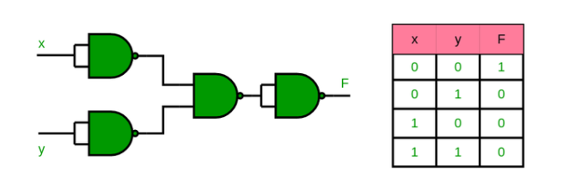
Number Systems and Logic Gates and Combining Logic Gates
b) Using NOR Gate
6. Implementation of NOR Gate using NAND Gates
Notes:
Source:https://www.techtarget.com/whatis/definition/logic-gate-AND-OR-XOR-NOT-NAND-NOR-and-XNOR

Slide 37
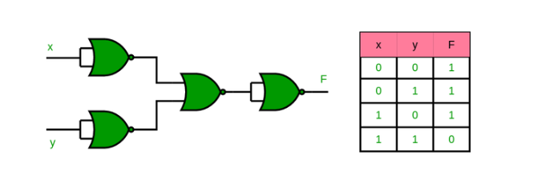
Number Systems and Logic Gates and Combining Logic Gates
7. Implementation of NAND Gate using NOR Gates
Notes:
Source:https://www.techtarget.com/whatis/definition/logic-gate-AND-OR-XOR-NOT-NAND-NOR-and-XNOR

Slide 38

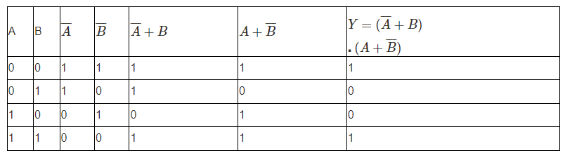
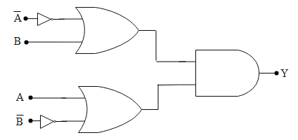
Number Systems and Logic Gates and Combining Logic Gates
Notes:
Source:https://www.techtarget.com/whatis/definition/logic-gate-AND-OR-XOR-NOT-NAND-NOR-and-XNOR

Slide 39
Number Systems and Logic Gates and Combining Logic Gates
Drawing a Circuit from a Maxterm and Minterm Boolean Expression
Minterm: A minterm is a product term in boolean function in which every element is present is either in normal or in complemented form.
For example if F(a,b,c) is a boolean function then the possible minterms would be abc, abc’, ab’c, ab’c’, a’bc, ab, c, a’b’c, a’b’c’ that is for n variable boolean function there would be 2^n possible minterms. There are used for sum of product(SOP) canonical forms, which is also called disjunctive normal form(DNF). The value correspond to 1 or true is selected as minterm.
Notes:
Source:https://www.techtarget.com/whatis/definition/logic-gate-AND-OR-XOR-NOT-NAND-NOR-and-XNOR

Slide 40
Number Systems and Logic Gates and Combining Logic Gates
Maxterm: A maxterm is a sum term in boolean function in which every element is present is either in normal or in complemented form. For example if F(a,b,c) is a boolean function then the possible maxterms would be (a+b+c), (a+b+c’), (a+b’+c), ( a+b’+c’), (a’+b+c), ( a+b’+c), ( a’+b’+c), (a’+b’+c’) . that is for n variable boolean function there would be 2^n possible maxterms. There are used for product of sum(POS) canonical forms, which is also called conjunctive normal form(CNF). The value correspond to 0 or false is selected as maxterm.
Notes:
Source:https://www.techtarget.com/whatis/definition/logic-gate-AND-OR-XOR-NOT-NAND-NOR-and-XNOR

Slide 41
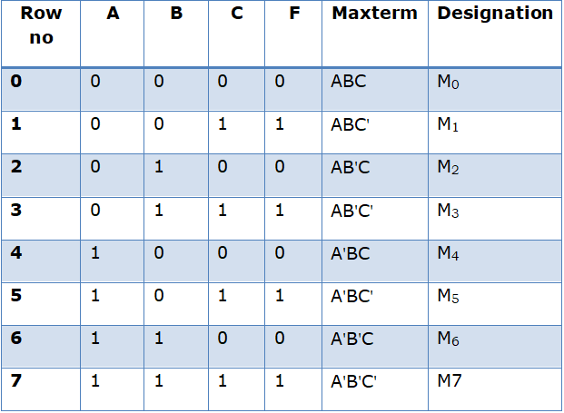
Number Systems and Logic Gates and Combining Logic Gates
Minterm and Maxterm
Boolean function can be put in two ways. They are
1. Canonical Minterm and
2. Canonical Maxterm.
Let us consider the below truth table and write the Boolean Minterm expression.
Minterm:
Minterm is a product term in which the Boolean variable is either normal or in complemented form.
Notes:
Source:https://www.techtarget.com/whatis/definition/logic-gate-AND-OR-XOR-NOT-NAND-NOR-and-XNOR

Slide 42
Number Systems and Logic Gates and Combining Logic Gates
Steps to write the Boolean Minterm expression:
Step 1:
A,B,C are the inputs and F is the output. To write the Minterm consider the rows which has the output F=1. In the above truth table m1, m3, m5, m7 have outputs ‘1’. The input which has the value ‘1’ is written as such and the input which has the value ‘0’ is complimented.
For example in the row 1, the output F=1 and the inputs A=B=0. So the inputs A and B are complimented and C is written as such. So the Minterm is A'B’C.
Step 2:
The Minterm f can be written as the sum of all the products of the row which has the output 1.
f= A'B'C+ A'BC+ AB'C+ ABC
It can also be represented as
f(A,B,C)= m1+ m3+ m5+ m7
Or it can be written as
f(A,B,C)= ∑m(1,3,5,7)
Notes:
Source:https://www.techtarget.com/whatis/definition/logic-gate-AND-OR-XOR-NOT-NAND-NOR-and-XNOR

Slide 43
Number Systems and Logic Gates and Combining Logic Gates
Maxterm:
Maxterm is a sum term in which the Boolean variable is either normal or in complemented form.
Notes:
Source:https://www.techtarget.com/whatis/definition/logic-gate-AND-OR-XOR-NOT-NAND-NOR-and-XNOR

Slide 44
Number Systems and Logic Gates and Combining Logic Gates
Steps to write the Boolean Maxterm expression:
Step 1:
A,B,C are the inputs and F is the output. To write the maxterm consider the rows which has the output F=0. In the above truth table M0, M2, M4, M6 have outputs ‘0’. The input which has the value ‘0’ is written as such and the input which has the value ‘1’ is complimented.
For example in the row 2, the output F=0 and the inputs A=C=0 and B=1. So the input B is complimented and A and C are written as such. So the maxterm is AB'C.
Step 2:
Considering all the rows which has the output ‘0’ the Maxterm can be written as
f= (A+B+C).(A+B'+C).(A'+B+C).(A'+B'+C) It can also be written as
f(A,B,C)= M0+M2+M4+M6
Or f(A,B,C)=πM (0,2,4,6)
Notes:
Source:https://www.techtarget.com/whatis/definition/logic-gate-AND-OR-XOR-NOT-NAND-NOR-and-XNOR

Slide 45
Number Systems and Logic Gates and Combining Logic Gates
Examples for Minterm and Maxterm:
Problem 1:
Express the Boolean function F=A+BC as minterm
F= A(B+B')(C+C')+BC(A+A')
By complement law A+A'=1. Adding all the input variables in the product terms we get
F=(AB+AB')(C+C')+ ABC+ A'BC
F= ABC+ABC'+AB'C+ABC'+AB'C'+ABC+A'BC
There are two ABCs and ABC'. So let us consider one ABC and ABC'
F= ABC+ ABC'+AB'C+ AB'C'+ A'BC
Notes:
Source:https://www.techtarget.com/whatis/definition/logic-gate-AND-OR-XOR-NOT-NAND-NOR-and-XNOR

Slide 46
Number Systems and Logic Gates and Combining Logic Gates
In minterm the ‘1’ input is written as such and the input ‘0’ is complimented.
F= 111+110+101+100+011
F= m7+m6+m5+m4+m3
F=∑m(3,4,5,6,7)
Notes:
Source:https://www.techtarget.com/whatis/definition/logic-gate-AND-OR-XOR-NOT-NAND-NOR-and-XNOR

Slide 47
Number Systems and Logic Gates and Combining Logic Gates
Problem 2:
Express the Boolean function F=A+BC as Maxterms
F=A+(BC)
After removing the bracket and expanding we get
F= (A+B).(A+C)
By complement law CC'=BB'=1. So after adding all input terms in the expression we get,
F= (A+B+CC').(A+C+BB')
F= (A+B+C).(A+B+C').(A+C+B).(A+C+B')
There are two (A+B+C)s. So let us consider one (A+B+C)
Notes:
Source:https://www.techtarget.com/whatis/definition/logic-gate-AND-OR-XOR-NOT-NAND-NOR-and-XNOR

Slide 48
Number Systems and Logic Gates and Combining Logic Gates
F= (A+B+C).(A+B+C').( A+B'+C)
In Maxterm the input ‘0’ is written as such and the input ‘1’ is complemented.
F=(0+0+0).(0+0+1).(0+1+0)
F= M0.M1.M2
F= πM(0,1,2)
Notes:
Source:https://www.techtarget.com/whatis/definition/logic-gate-AND-OR-XOR-NOT-NAND-NOR-and-XNOR

Slide 49
Number Systems and Logic Gates and Combining Logic Gates
Truth Tables, Logic, and De Morgan's Laws
Boolean Algebra Expressions can be used to construct digital logic truth tables for their respective functions.
As well as a standard Boolean Expression, the input and output information of any Logic Gate or circuit can be plotted into standard Boolean Algebra truth tables to give a visual representation of the switching function of the system.
The table used to represent the boolean expression of a logic gate function is commonly called a Truth Table.
Notes:
Source:https://www.techtarget.com/whatis/definition/logic-gate-AND-OR-XOR-NOT-NAND-NOR-and-XNOR

Slide 50
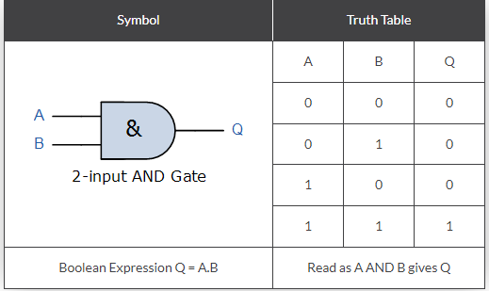
Number Systems and Logic Gates and Combining Logic Gates
Boolean Algebra Truth Tables For A 2-input AND Gate
For a 2-input AND gate, the output Q is true if BOTH input A “AND” input B are both true, giving the Boolean Expression of: ( Q = A and B ).
Note that the Boolean Expression for a two input AND gate can be written as: A.B or just simply AB without the decimal point.
Notes:
Source:https://www.techtarget.com/whatis/definition/logic-gate-AND-OR-XOR-NOT-NAND-NOR-and-XNOR

Slide 51
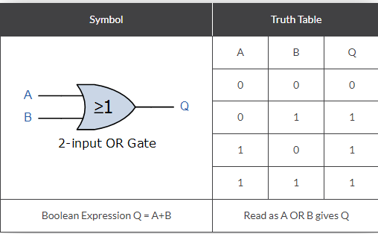
Number Systems and Logic Gates and Combining Logic Gates
Boolean Algebra Truth Tables For A 2-input OR Gate
For a 2-input OR (Inclusive-OR) gate, the output Q is true if EITHER input A “OR” input B is true, giving the Boolean Expression of: ( Q = A or B ).
Notes:
Source:https://www.techtarget.com/whatis/definition/logic-gate-AND-OR-XOR-NOT-NAND-NOR-and-XNOR

Slide 52
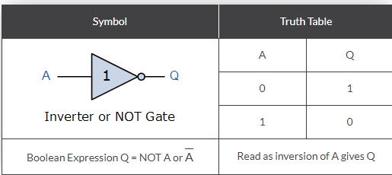
Number Systems and Logic Gates and Combining Logic Gates
Boolean Algebra Truth Tables For The NOT Gate
For a single input NOT (Inverter) gate, the output Q is ONLY true when the input is “NOT” true, the output is the inverse or complement of the input giving the Boolean Expression of: ( Q = NOT A ).
The NAND and the NOR Gates are a combination of the AND and OR Gates respectively with that of a NOT Gate (inverter).
Notes:
Source:https://www.techtarget.com/whatis/definition/logic-gate-AND-OR-XOR-NOT-NAND-NOR-and-XNOR

Slide 53
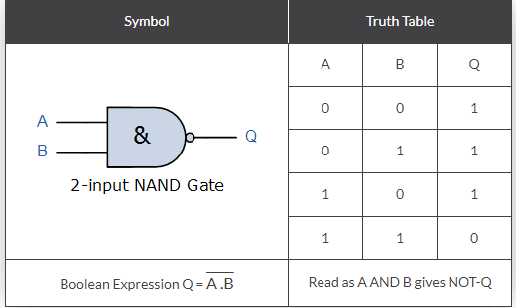
Number Systems and Logic Gates and Combining Logic Gates
The NAND and the NOR Gates are a combination of the AND and OR Gates respectively with that of a NOT Gate (inverter).
Notes:
Source:https://www.techtarget.com/whatis/definition/logic-gate-AND-OR-XOR-NOT-NAND-NOR-and-XNOR

Slide 54
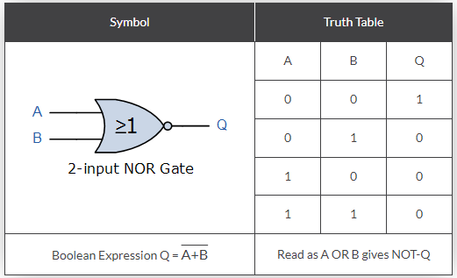
Number Systems and Logic Gates and Combining Logic Gates
2-input NOR (Not OR) Gate
For a 2-input NOR gate, the output Q is true if BOTH input A and input B are NOT true, giving the Boolean Expression of: ( Q = not(A OR B) ).
As well as the standard logic gates there are also two special types of logic gate function called an Exclusive-OR Gate and an Exclusive-NOR Gate. The Boolean expression to indicate an Exclusive-OR or Exclusive-NOR function is to a symbol with a plus sign inside a circle, ( ⊕ ).
The switching actions of both of these types of gates can be created using the above standard logic gates. However, as they are widely used functions they are now available in standard IC form and have been included here as reference.
Notes:
Source:https://www.techtarget.com/whatis/definition/logic-gate-AND-OR-XOR-NOT-NAND-NOR-and-XNOR

Slide 55
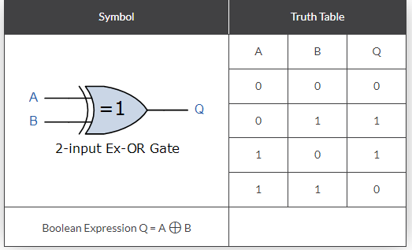
Number Systems and Logic Gates and Combining Logic Gates
2-input EX-OR (Exclusive OR) Gate
For a 2-input Ex-OR gate, the output Q is true if EITHER input A or if input B is true, but NOT both giving the Boolean Expression of: ( Q = (A and NOT B) or (NOT A and B) ).
Notes:
Source:https://www.techtarget.com/whatis/definition/logic-gate-AND-OR-XOR-NOT-NAND-NOR-and-XNOR

Slide 56
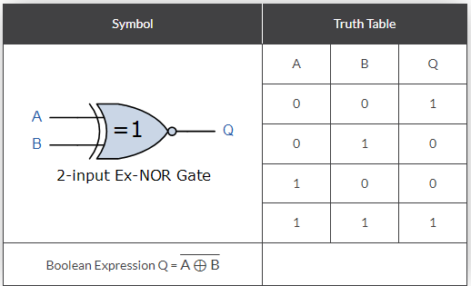
Number Systems and Logic Gates and Combining Logic Gates
2-input EX-NOR (Exclusive NOR) Gate
For a 2-input Ex-NOR gate, the output Q is true if BOTH input A and input B are the same, either true or false, giving the Boolean Expression of: ( Q = (A and B) or (NOT A and NOT B) ).
Notes:
Source:https://www.techtarget.com/whatis/definition/logic-gate-AND-OR-XOR-NOT-NAND-NOR-and-XNOR

Slide 57
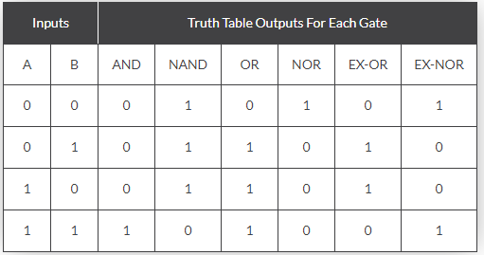
Number Systems and Logic Gates and Combining Logic Gates
Summary of 2-input Logic Gates
The following Boolean Algebra Truth Tables compare the logical functions of the 2-input logic gates.
Notes:
Source:https://www.techtarget.com/whatis/definition/logic-gate-AND-OR-XOR-NOT-NAND-NOR-and-XNOR

Slide 58
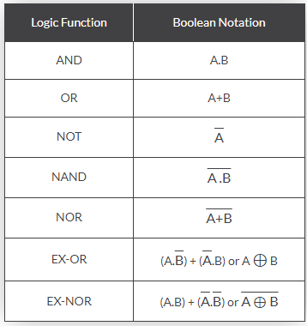
Number Systems and Logic Gates and Combining Logic Gates
The following Boolean Algebra truth tables gives a list of the common logic functions and their equivalent Boolean notation.
Notes:
Source:https://www.techtarget.com/whatis/definition/logic-gate-AND-OR-XOR-NOT-NAND-NOR-and-XNOR

Slide 59
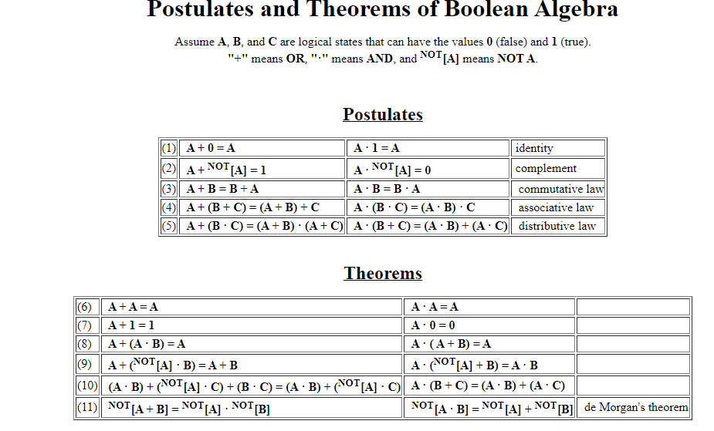
Number Systems and Logic Gates and Combining Logic Gates
Notes:
Source:https://www.techtarget.com/whatis/definition/logic-gate-AND-OR-XOR-NOT-NAND-NOR-and-XNOR

Slide 60
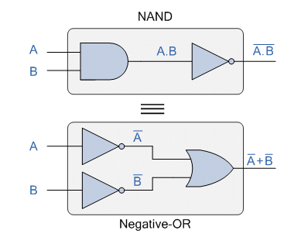
Number Systems and Logic Gates and Combining Logic Gates
DeMorgan’s Theorem
Augustus DeMorgan (a nineteenth century English mathematician) which views the logical NAND and NOR operations as separate NOT AND and NOT OR functions respectively.
DeMorgan´s Theorem and Laws can be used to to find the equivalency of the NAND and NOR gates
Notes:
https://www.electronics-tutorials.ws/boolean/demorgan.html

Slide 61
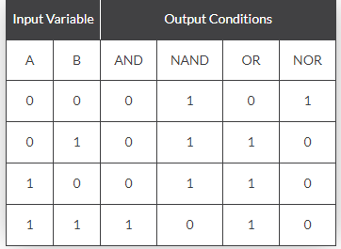
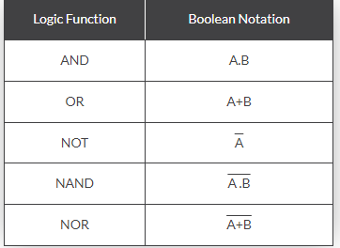
Number Systems and Logic Gates and Combining Logic Gates
Truth Table for Each Logical Operation
The following table gives a list of the common logic functions and their equivalent Boolean notation
Notes:
https://www.electronics-tutorials.ws/boolean/demorgan.html

Slide 62
Number Systems and Logic Gates and Combining Logic Gates
De Morgan’s Theorems
DeMorgan’s Theorems are basically two sets of rules or laws developed from the Boolean expressions for AND, OR and NOT using two input variables, A and B. These two rules or theorems allow the input variables to be negated and converted from one form of a Boolean function into an opposite form.
DeMorgan’s First Theorem
DeMorgan’s First theorem proves that when two (or more) input variables are AND’ed and negated, they are equivalent to the OR of the complements of the individual variables. Thus the equivalent of the NAND function will be a negative-OR function, proving that A.B = A+B. We can show this operation using the following table.
Notes:
https://www.electronics-tutorials.ws/boolean/demorgan.html

Slide 63
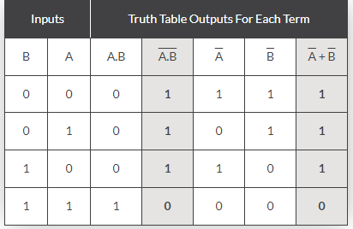

Number Systems and Logic Gates and Combining Logic Gates
Verifying DeMorgan’s First Theorem using Truth Table
Hence
Notes:
https://www.electronics-tutorials.ws/boolean/demorgan.html

Slide 64
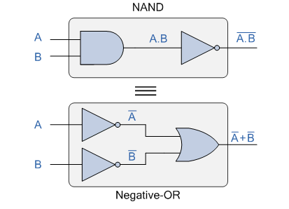
Number Systems and Logic Gates and Combining Logic Gates
DeMorgan’s First Law Implementation using Logic Gates
We can also show that A.B = A+B using logic gates as shown.
The top logic gate arrangement of: A.B can be implemented using a standard NAND gate with inputs A and B. The lower logic gate arrangement first inverts the two inputs producing A and B. These then become the inputs to the OR gate. Therefore the output from the OR gate becomes: A+B
Notes:
https://www.electronics-tutorials.ws/boolean/demorgan.html

Slide 65
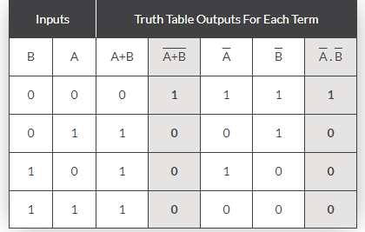
Number Systems and Logic Gates and Combining Logic Gates
DeMorgan’s Second Theorem
DeMorgan’s Second theorem proves that when two (or more) input variables are OR’ed and negated, they are equivalent to the AND of the complements of the individual variables. Thus the equivalent of the NOR function is a negative-AND function proving that A+B = A.B, and again we can show operation this using the following truth table.
Verifying DeMorgan’s Second Theorem using Truth Table
Notes:
https://www.electronics-tutorials.ws/boolean/demorgan.html

Slide 66
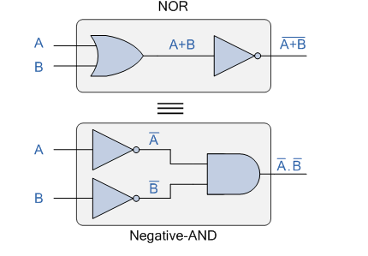
Number Systems and Logic Gates and Combining Logic Gates
DeMorgan’s Second Law Implementation using Logic Gates
The top logic gate arrangement of: A+B can be implemented using a standard NOR gate function using inputs A and B. The lower logic gate arrangement first inverts the two inputs, thus producing A and B. Thus then become the inputs to the AND gate. Therefore the output from the AND gate becomes: A.B
Notes:
https://www.electronics-tutorials.ws/boolean/demorgan.html

Slide 67
Number Systems and Logic Gates and Combining Logic Gates
For a 3-variable input
A.B.C = A+B+C
and also
A+B+C = A.B.C
For a 4-variable input
A.B.C.D = A+B+C+D
and also
A+B+C+D = A.B.C.D
and so on.
Notes:
https://www.electronics-tutorials.ws/boolean/demorgan.html

Slide 68
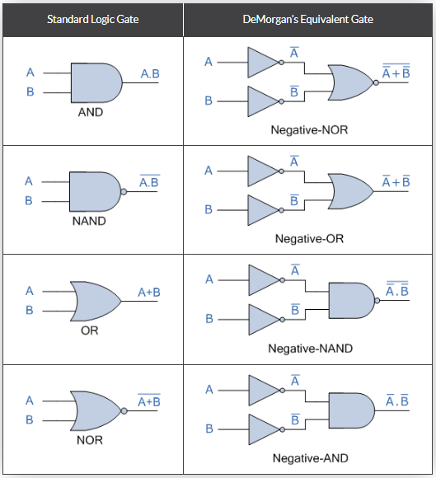
Number Systems and Logic Gates and Combining Logic Gates
De Morgan’s Equivalent Gates

Slide 69
Number Systems and Logic Gates and Combining Logic Gates
Problems on DeMorgan:
Example 1: (A.B.C)'
(A.B.C)'=A'+B'+C’
Example 2: (A+B+C)'
(A+B+C)'=A'.B’.C
Example 3: ((A+BC')'+D(E+F')')'
For applying the DeMorgan's theorem on this expression, we have to follow the following expressions:
1) In complete expression, first, we find those terms on which we can apply the DeMorgan's theorem and treat each term as a single variable.
Notes:
https://www.electronics-tutorials.ws/boolean/demorgan.html

Slide 70
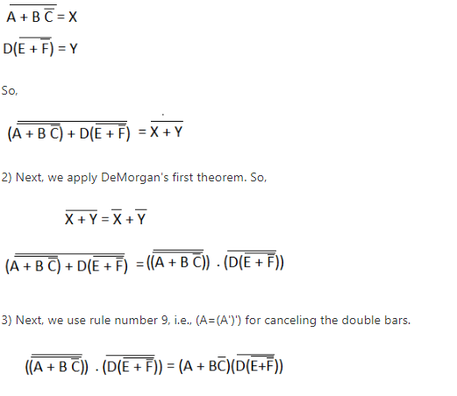
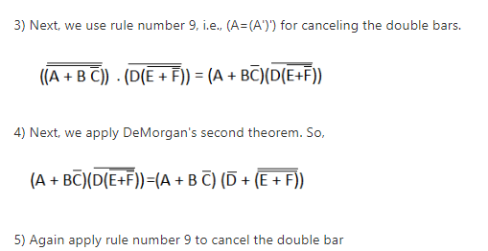

Number Systems and Logic Gates and Combining Logic Gates
Example 3: ((A+BC')'+D(E+F')')'
Notes:
https://www.electronics-tutorials.ws/boolean/demorgan.html

Slide 71
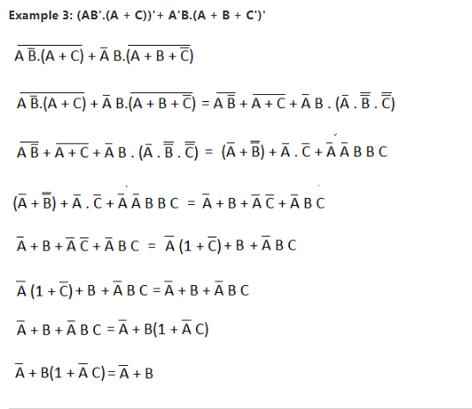
Number Systems and Logic Gates and Combining Logic Gates
Notes:
https://www.electronics-tutorials.ws/boolean/demorgan.html

Slide 72
Number Systems and Logic Gates and Combining Logic Gates
Summary
By accepting and altering binary input and output, logic gates control the flow of electricity via an electrical circuit.
To enable an electronic logic operation, learning of logic gates are essential.
Electronic circuit board design is governed by the underlying logic system known as digital logic.
The manipulation of binary values using printed circuit board technology, which employs circuits and logic gates to create the execution of computer processes, is known as digital logic.

Slide 73
Number Systems and Logic Gates and Combining Logic Gates
Summary
A gate that can implement any Boolean operation without the aid of any other gate type is known as a universal gate. The NAND and NOR gates are two examples of universal gates. Since NAND and NOR gates are the fundamental gates used in all IC digital logic families and are less expensive and simpler to manufacture, this is useful in practise.
De Morgan's Theorem, is an especially effective technique for digital design. Theorem: The complement of the product of all terms is equal to the complement of each term added together. Similarly, the product of the complements of each phrase equals the complement of the sum of all the words.

Slide 74

Number Systems and Logic Gates and Combining Logic Gates
Self Assessment Questions(SAQs)
1) Which of the following gates generates the truth table shown?
AND gate
OR gate
NAND gate
NOR gate
XOR gate
ANS: e is CORRECT.

Slide 75

Number Systems and Logic Gates and Combining Logic Gates
Self Assessment Questions(SAQs)
2) The gate function illustrated is an equivalent representation for an
AND gate
OR gate
NAND gate
NOR gate
XOR gate
ANS: c
This is the alternate symbolic form for a NAND gate (2 bubbles attached to the inputs of an OR), which comes from the DeMorgan’s property
NAND: (xy)' = x' + y' The bubble represents a NOT operation (inversion).

Slide 76
Number Systems and Logic Gates and Combining Logic Gates
Self Assessment Questions(SAQs)
3) Identify the function generated by the logic network illustrated.
F = A
F = AB'C
F = ABC
F = (A+B)C
F = (A+B')C Ans: c is CORRECT. The correct function generated by this logic network is F(A,B,C) = ABC.

Slide 77
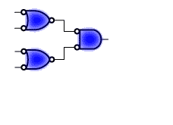
Number Systems and Logic Gates and Combining Logic Gates
Self Assessment Questions(SAQs)
4) Identify the gate elements in the circuit below.
2 OR and 1 NAND
2 NAND and 1 OR
2 AND and 1 NOR
2 NOR and 1 NAND
2 NAND and 1 NOR
ANS: c is CORRECT. This circuit utilizes alternate symbolic forms for all the gates shown. The first 2 are AND gates (a OR symbol with 3 bubbles), which then feed a NOR gate (a AND symbol with 2 bubbles in the back, also drawn in alternate symbolic form.

Slide 78
Number Systems and Logic Gates and Combining Logic Gates
Self Assessment Questions(SAQs)
5) The logical gates are categorized into _______
One group
Two groups
Three groups
Four Groups
ANS: c

Slide 79
Number Systems and Logic Gates and Combining Logic Gates
Self Assessment Questions(SAQs)
6) _______ are basic gates
NOT
NAND
AND
NOT,AND,OR
ANS: d

Slide 80
Number Systems and Logic Gates and Combining Logic Gates
Self Assessment Questions(SAQs)
7) _______ are UNIVERSAL gates
NOT
NAND & NOR
AND
NOT,AND,OR
ANS: b

Slide 81
Number Systems and Logic Gates and Combining Logic Gates
Self Assessment Questions(SAQs)
8) _______ are ARITHMETIC gates
NOT
NAND & NOR
X-OR & N-OR
NOT,AND,OR
ANS: c

Slide 82
Compute outputs
Number Systems and Logic Gates and Combining Logic Gates
Self Assessment Questions(SAQs)
9) Combinational logic is used to ___________
Compute Outputs
Compute New States
Both 1 and 2
None of the above
ANS: 3

Slide 83
Number Systems and Logic Gates and Combining Logic Gates
Self Assessment Questions(SAQs)
10) The product of sums canonical forms also known as ________
Max term
Conjunctive Normal Form
Both 1 and 2
None of the above
ANS: c

Slide 84
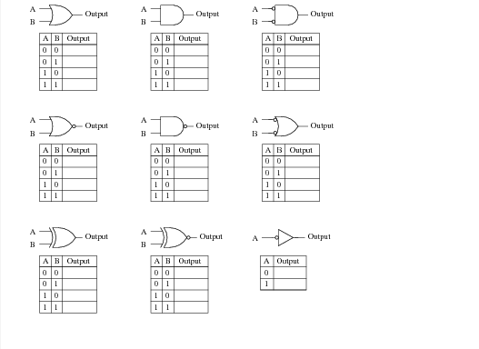
Number Systems and Logic Gates and Combining Logic Gates
Assignment 1
Identify each of these logic gates by name, and complete their respective truth tables:
Notes:
Source:https://www.bartleby.com/questions-and-answers/identify-each-of-these-logic-gates-by-name-and-complete-their-respective-truth-tables-d-ostput-oupet/9e912345-88e1-439a-8b0a-686b8c9ccf05

Slide 85

Number Systems and Logic Gates and Combining Logic Gates
Assignment 2
Complete the truth table for a three-input AND gate:
A | B | C | Output
0 | 0 | 0
0 | 0 | 1
0 | 1 | 0
0 | 1 | 1
1 | 0 | 0
1 | 0 | 1
1 | 1 | 0
1 | 1 | 1
Notes:
Source:https://www.pinterest.com/pin/596515913144131895/

Slide 86
Number Systems and Logic Gates and Combining Logic Gates
Document Link: e-References
Topic | URL | Notes
Logic Gates | http://www.gatestudy.com/wp-content/uploads/2014/06/MCQ4-DC-LOGIC-GATES.pdf | MCQ4-DC-LOGIC-GATES.pdf
De Morgan’s Theorem | https://www.sciencedirect.com/topics/computer-science/de-morgans-theorem | Combinational Logic Design and De Morgan’s Theorem

Slide 87
Number Systems and Logic Gates and Combining Logic Gates
Video Link
Topics | URL | Notes
Logic Gates, Truth Tables, Boolean Algebra AND, OR, NOT, NAND & NOR | https://youtu.be/JQBRzsPhw2w | This link explains the logic gates , truth table and Boolean algebra .
SOP and POS | https://www.coursera.org/lecture/computational-thinking-problem-solving/1-2-decomposition-phmNk | This link explains Boolean Function Representation: SOP and POS Form , Minterms and Maxterms.
De Morgan’s Theorem | https://youtu.be/RrynEQ7sG5A | This link explains De Morgan’s Theorem | Understand circuit simplification | Boolean algebra basics

Slide 88
Number Systems and Logic Gates and Combining Logic Gates
E- Book Link
Topics | URL | Notes
Digital Logic and Computer Design | https://b-ok.asia/book/5339972/313bee | Understanding of how to design the logic circuits.
Digital Electronics: Principles and Applications | https://b-ok.asia/book/2703250/e547c7 | Understanding of the basic Digital Electronics concepts.
Computer organization and embedded systems | https://b-ok.asia/book/1207173/7edee7 | Understanding the key topics in computer organization and embedded systems. It presents hardware design principles and shows how hardware design is influenced by the requirements of software

Slide 89


